Slide 1

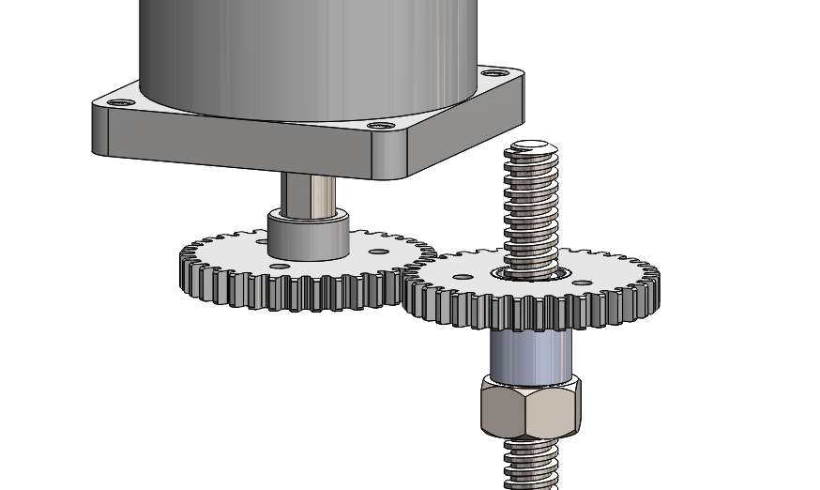
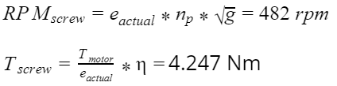
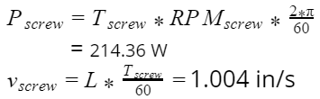


Assignment 1- Gear Train and Power Screw Selection
MECH 325, Team E4
October 14th, 2019
Input Power From Motor P_{M} | Power to Screw P_{Screw} | Gear Train Value e | Efficiency η | Gel Flow Rate Q | Overall Cost C (USD) | Performance Metric Q/C
212.7 W | 199.9 w | 1 | 94% | 200 ml/s | $39.84 | 4.64
Assumptions:
Steel on steel friction coefficient between the power screw and nut is 0.17
Gears run in an environment where the ambient temperature is 20°C
Gears are initially lubricated with oil, but no maintenance is applied
The entire gear train is assumed to be 94% efficient (0.98³)
If we select nylon gear, there are negligible differences between types of nylon between manufacturers.
Final Design
Calculations:
= 4.64 ml/s$
Parts Used:
Part # | Part | Supplier | Description | Cost ($USD)
57655K58 | Driven Gear | McMaster-Carr | 14.5°, 2.25’’ø, 36 tooth nylon gear, 16 TPI | $15.83
57655K58 | Driving Gear | McMaster-Carr | 14.5°, 2.25’’ø, 36 tooth nylon gear, 16 TPI | $15.83
98935A715 | Lead Screw | McMaster-Carr | Carbon Steel, ACME, RH, ½’’-8 thread, 0.125’’ per rev, 12’’ long | $6.00
94815A107 | Nut | McMaster-Carr | Carbon steel, ACME, RH, ½” - 10 thread, 0.1” per rev | $2.68
Team members
Amran Osman
Friend Prakitpong
Gianni Co
Hassan Iqbal
Husein Alatas
Ricky Asfour
Steven McCulloch

